Slide 1
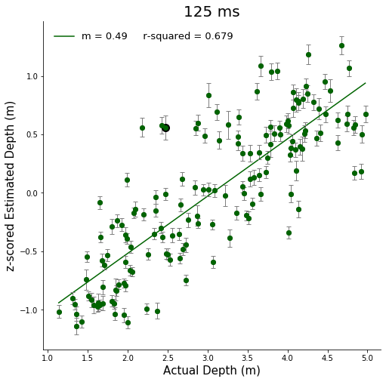
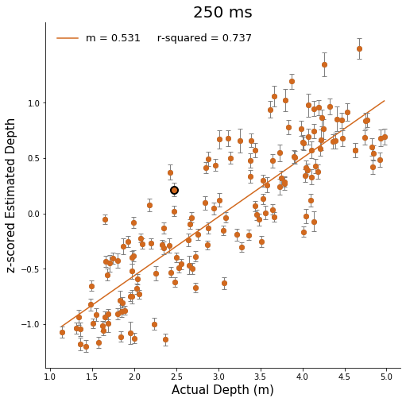
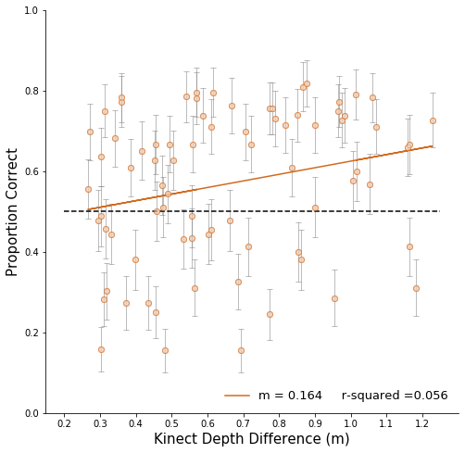
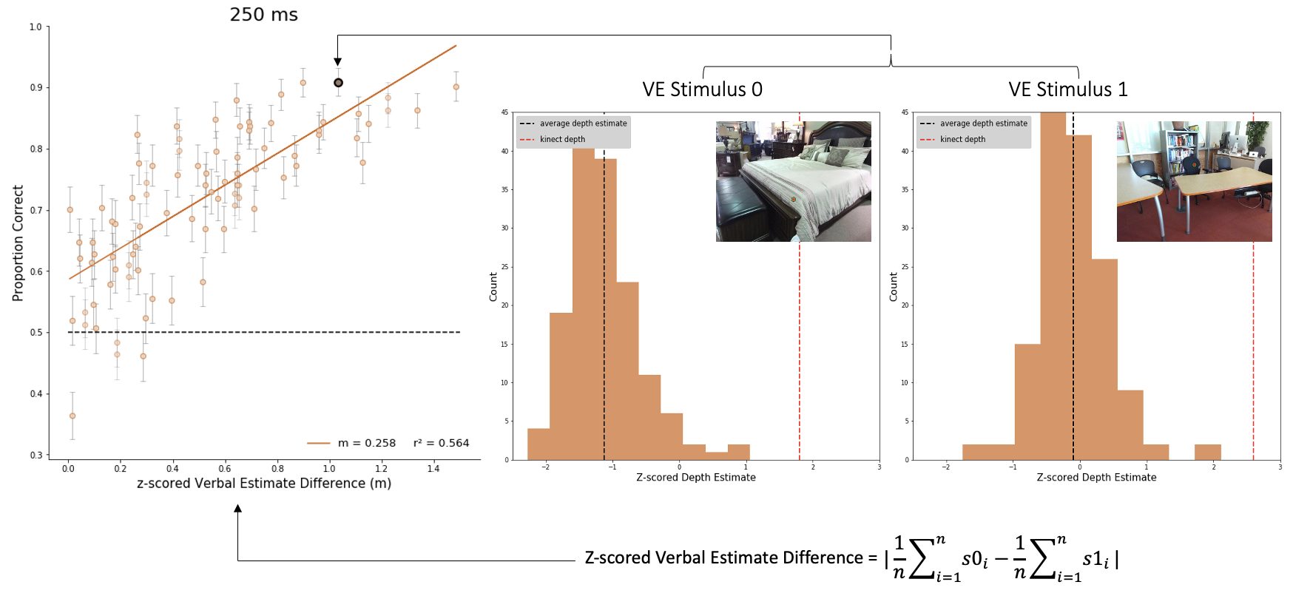
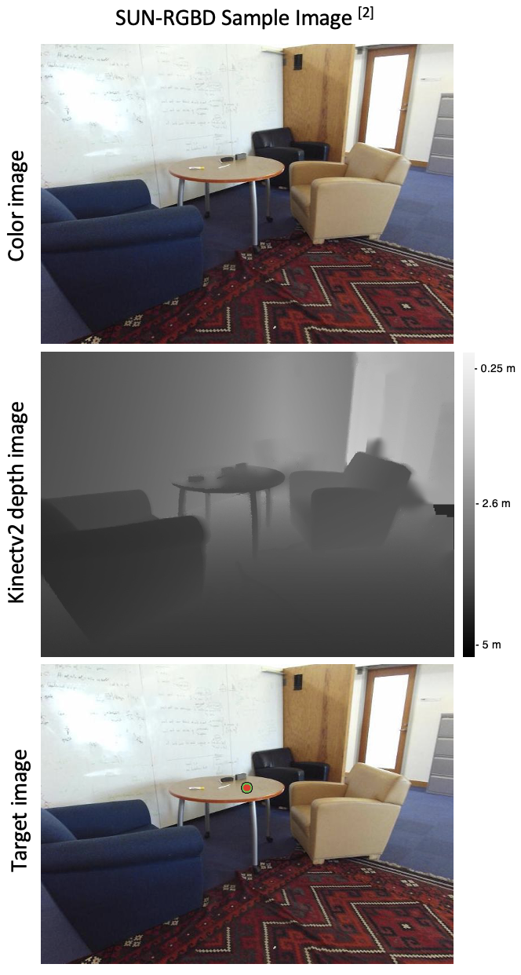
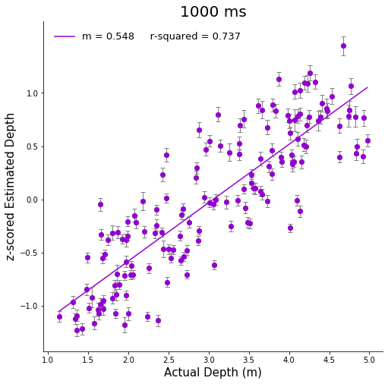
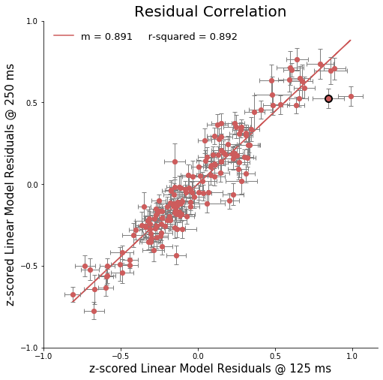
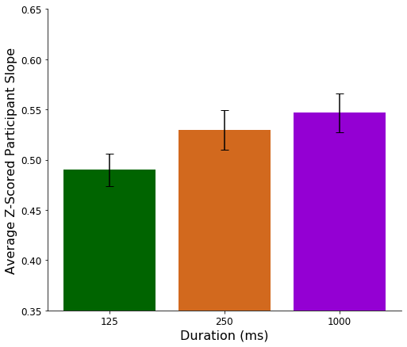
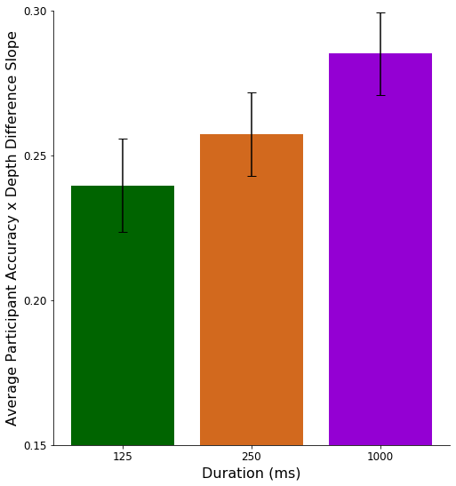
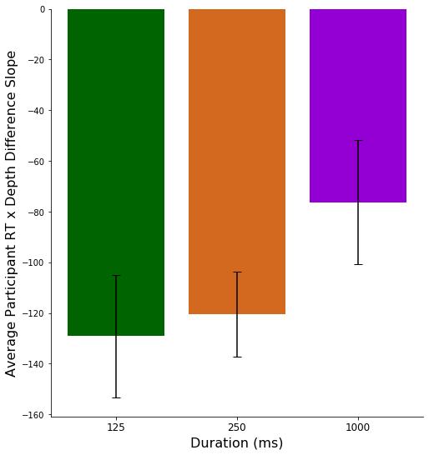
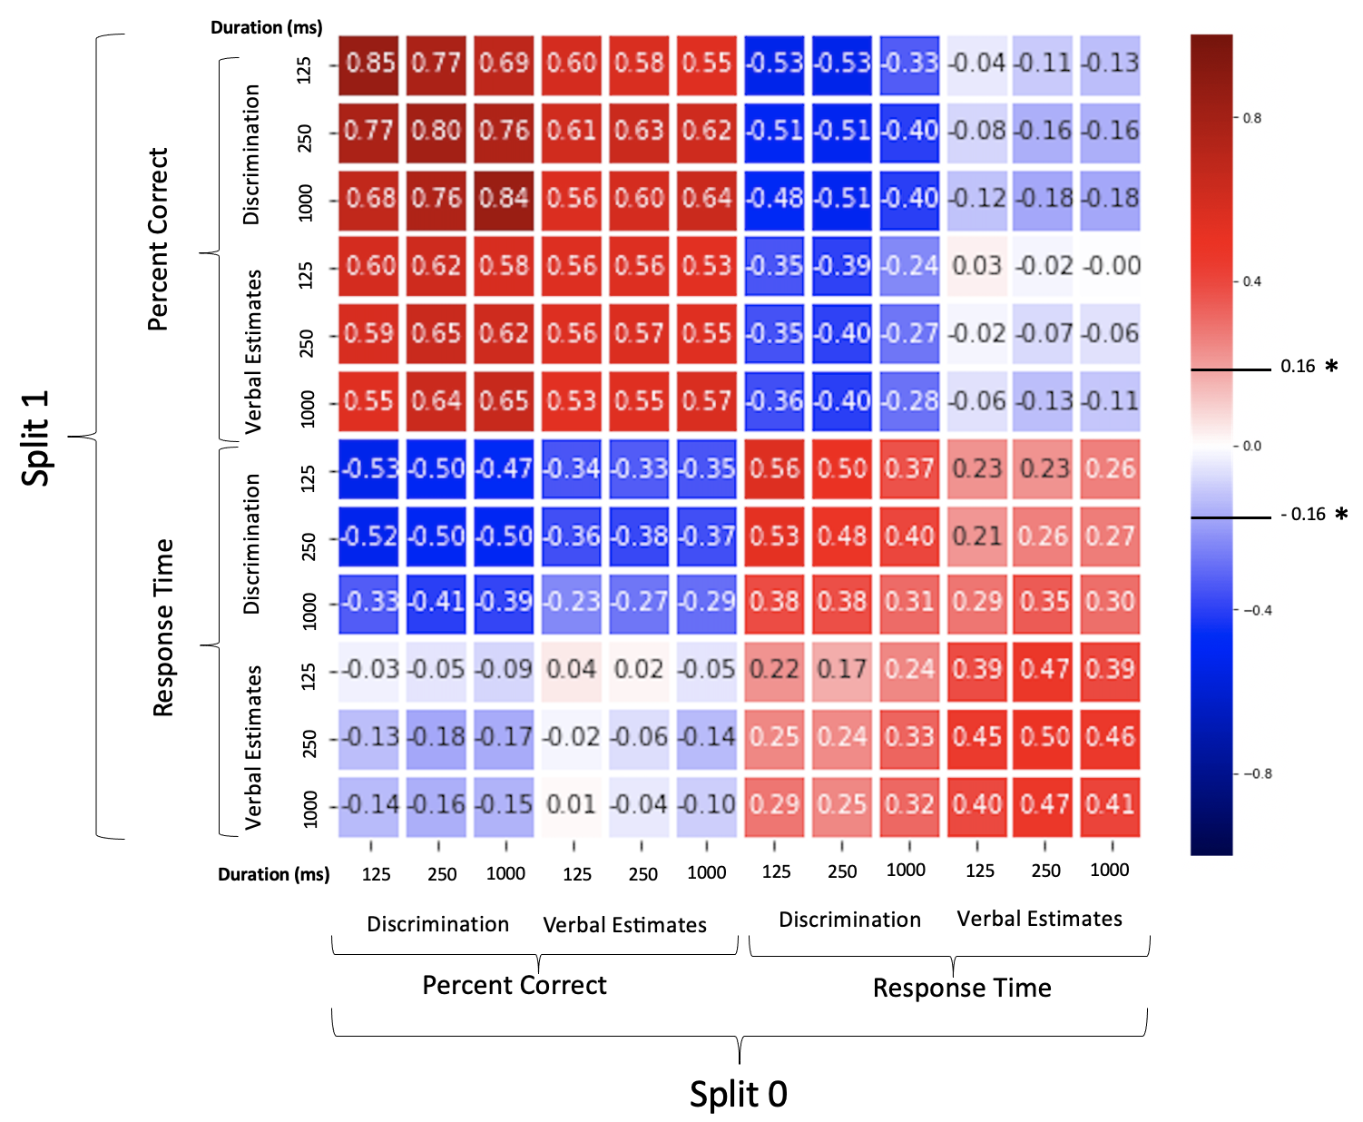

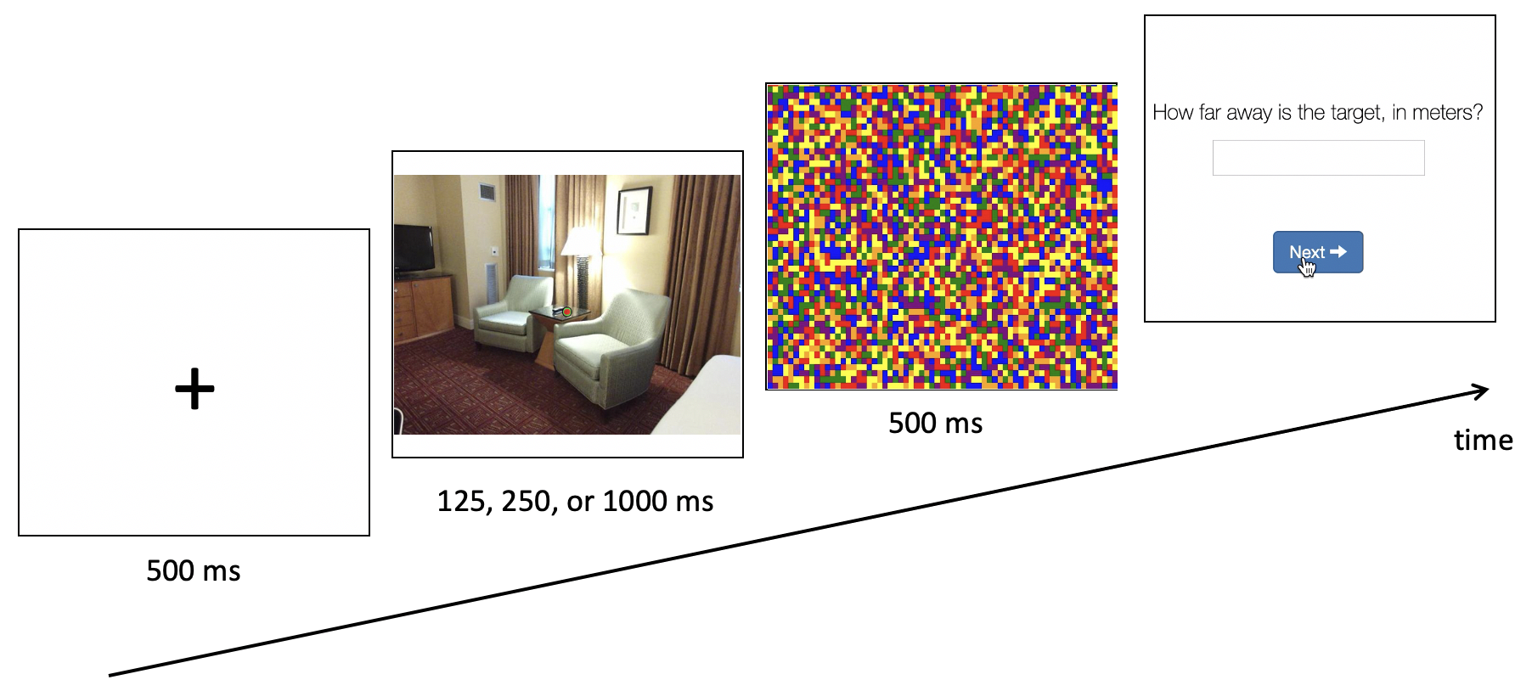

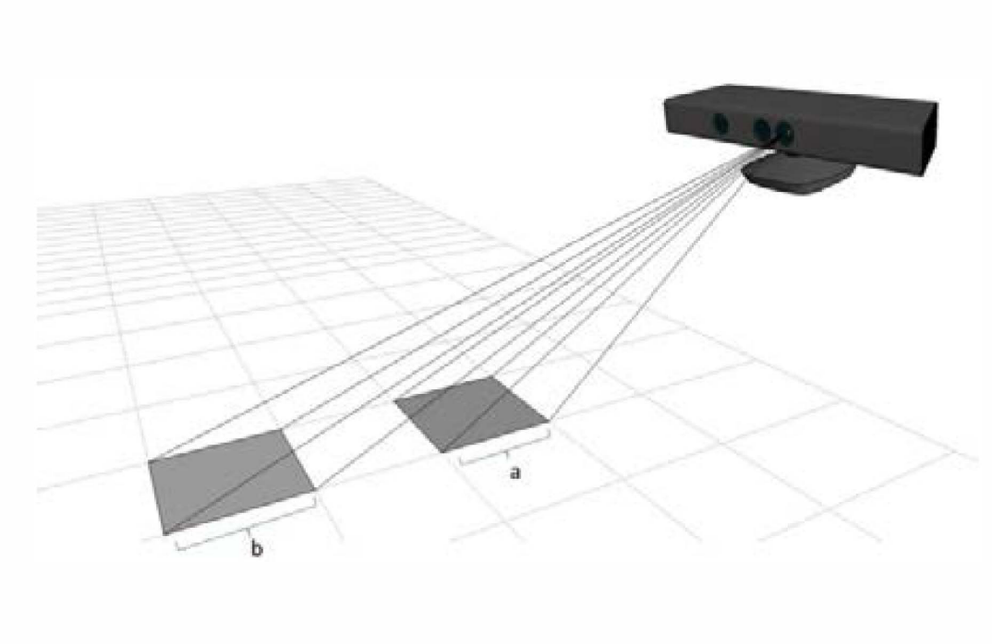
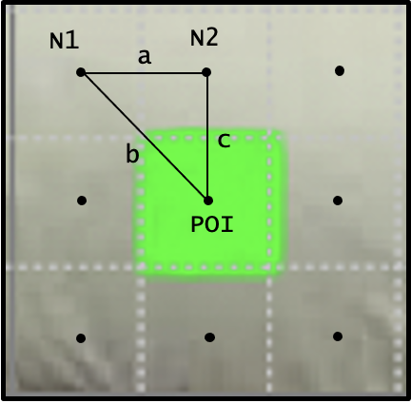
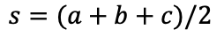
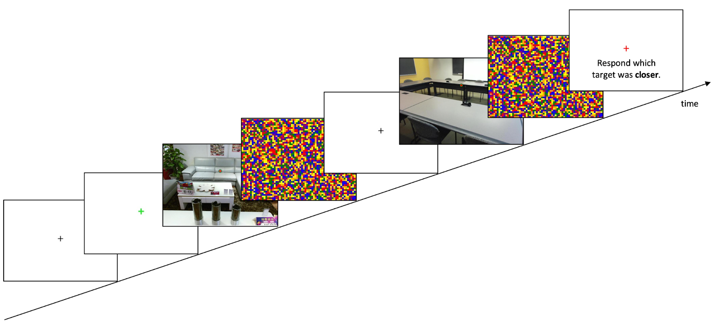
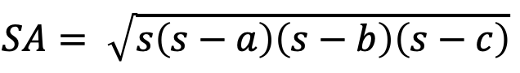
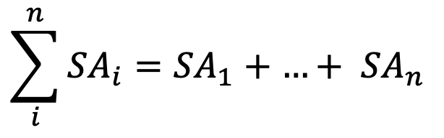
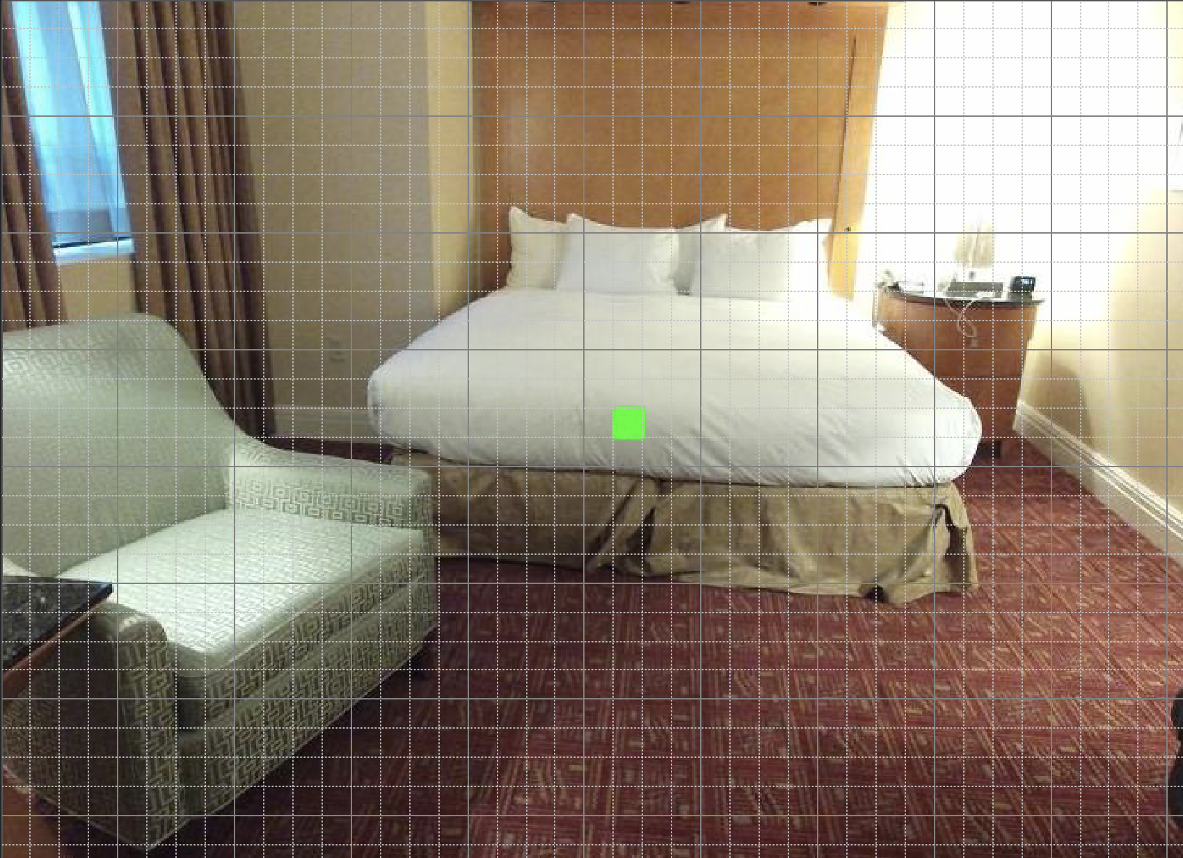
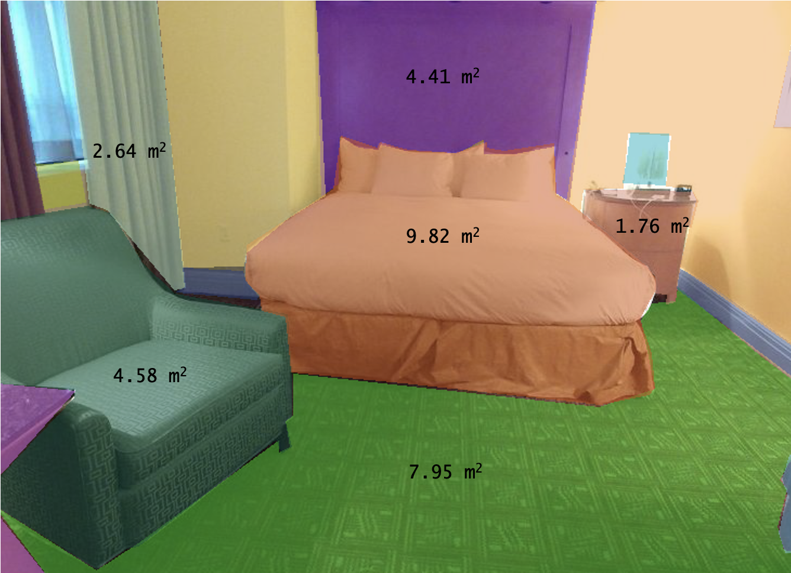
A Novel Generalization between Verbal Judgments and
Perceptual Discrimination of 3D Space
Prachi Mahableshwarkar, Lindsay Houck, John W. Philbeck, and Dwight J. Kravitz
Department of Psychological and Brain Sciences, The George Washington University
Introduction
Despite the lack of oculomotor and binocular disparity cues, humans are capable of visual distance perception in pictured scenes. Here we leverage crowd-sourced data collection to model the influence of spatial cues with temporal processing differences.
Verbal Estimate
Discrimination
How predictable is discrimination performance from Kinect tagged depths?
How predictable is discrimination performance from independent verbal judgments (Exp 1)?
250 ms
250 ms
Z-scored Estimated Depth
Z-scored Estimated Depth
Constrain the axes even more – get rid of the white space
Test all of these against 0 for significance
Then all against each other ANOVA and the pairwise tests
Proportion Correct
Proportion Correct
Discrimination performance (accuracy and RT) was more strongly predicted by signal detection analyses applied to the verbal estimates for the corresponding stimuli in each discrimination (R2 = .57, p < 10^-14) than Kinect tagged depths.
Stimuli
Actual Depth (m)
Actual Depth (m)
Make title (residual correlation)
- Add error bars
In the scatter plot pick a scene and show a bracket diff between the point and the line
Then have an arrow to the point on the residual plot
Z-scored Estimated Depth
Z-scored Linear Model Residuals @ 250 ms
Kinect Depth Difference (m)
Z-scored Verbal Estimate Difference (m)
Z-scored Depth Estimate
Z-scored Depth Estimate
Discrimination Summary Plots
Stimulus Driven Task Generalization
Discrimination accuracy, predicted by independent verbal judgments (VE), showed increasing sensitivity to distance with longer viewing durations (F = X, p < X). Discrimination response times show a significant negative linear relationship with VE depth differences, wherein larger differences result in quicker response times. This relationship strengthens as viewing duration increases.
Actual Depth (m)
Z-scored Linear Model Residuals @ 125 ms
*
We found high reliability in the relationships between tasks, participants, and viewing duration in the complete dataset and after repeatedly splitting the data into independent subsets and evaluating the average correlation matrix. Groups of subjects were selected repeatedly at random within each combination of task and duration. Independent correlations across all combinations of task (VE, Discrimination), outcome (percent correct, RT), and duration (125 ms, 250 ms, 1000 ms) were calculated and averaged across all random splits. We find a strong degree of generalization between task, duration, and outcome as a product of the stimulus-driven signal.
Key Findings:
Strong correlations along the main diagonal
Significant negative correlations between accuracy and RT in discrimination and VE
Percent correct from VE is significantly correlated with percent correct from discrimination at each duration
At each duration, response time from discrimination can significantly predict accuracy in VE
*
Do these plots by participant
So that error bars are between subject standard error
The residuals for the linear model (Z-scored estimated depth x actual depth) at 125 ms and 250 ms for example are highly related, suggesting stable and systematic biases for individual stimuli across viewing duration even at brief glimpses.
- Target
Duration (ms)
Duration (ms)
Experimental Paradigms
Conclusion
The generalization across tasks and participants suggests a stable and strong relationship between verbal report and discrimination, allowing for the creation of an explicit model that relates stimulus-based visual cues and 3D picture perception. Future work will quantify and model the influence of various visual cues, such as familiar size, on behavioral performance.
Verbal Estimate (VE) of Distance
156 trials, Latin-square counterbalancing
https://osf.io/28vjd
Familiar Size Algorithm
3D Space: (x_{res}, y_{res}, depth)
Pixel Surface Area
Distance Discrimination
78 trials, Latin-square counterbalancing
Key-press response (‘m’ or ‘z’)
Object Surface Area
Calculating real world object dimensions from Kinect RGB-D image using dynamic resolution. ^{[1]}
Sample Output
Independent groups of participants
VE @ 125 ms (N = 156)
VE @ 250 ms (N = 156)
VE @ 1000 ms (N = 156)
Discrimination @ 125 ms (N = 156)
Discrimination @ 250 ms (N = 156)
Discrimination @ 1000 ms (N = 156)
References
[1] Anwer, A., Baig, A., & Nawaz, R. (2015). Calculating Real World Object Dimensions from Kinect RGB-D image using dynamic resolution. 2015 12th International Bhurban Conference on Applied Sciences and Technology (IBCAST).
[2] Song, S., Lichtenberg, S. P., &amp; Xiao, J. (2015). Sun RGB-D: A RGB-D scene understanding benchmark suite. 2015 IEEE Conference on Computer Vision and Pattern Recognition (CVPR).
Contact: pmahable@gwmail.gwu.edu

